Slide 1

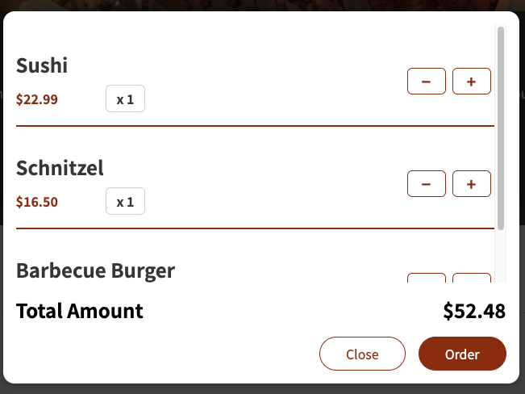
App
CartProvider
Component
Data / State
Handler
true
showCartHandler
cartContext
cartIsShown
false
Render
hideCartHandler
addItem
Read
removeItem
Render
onClose={hideCartHandler}
onCartOpen={showCartHandler}
Meals
Cart
Header
Render
cartContext
onClick={props.onClose}
Render
read
cartItemRemoveHandler
onClick={props.onCartOpen}
AvailableMeals
cartItemAddHandler
Render cartItems
HeaderCartButton
DUMMY_MEALS
Render MealItems
.items.map
.meals.map
cartContext
onRemove={cartItemRemoveHandler.bind(null, item.id)}
onAdd={cartItemAddHandler.bind(null, item)}
nrOfCartItems
MealItem
button
cartContext
CartItem
addToCartHandler
Render
onAddToCart={addToCartHandler}
Amount
MealItemForm
Input
React.forwardRef((props, ref)
ref
Input amount
Add button

